Slide 1
Computer Security Information Security & Risk Management
by Akkradach W.
Dept. of Computer Engineering
KMITL

Slide 2
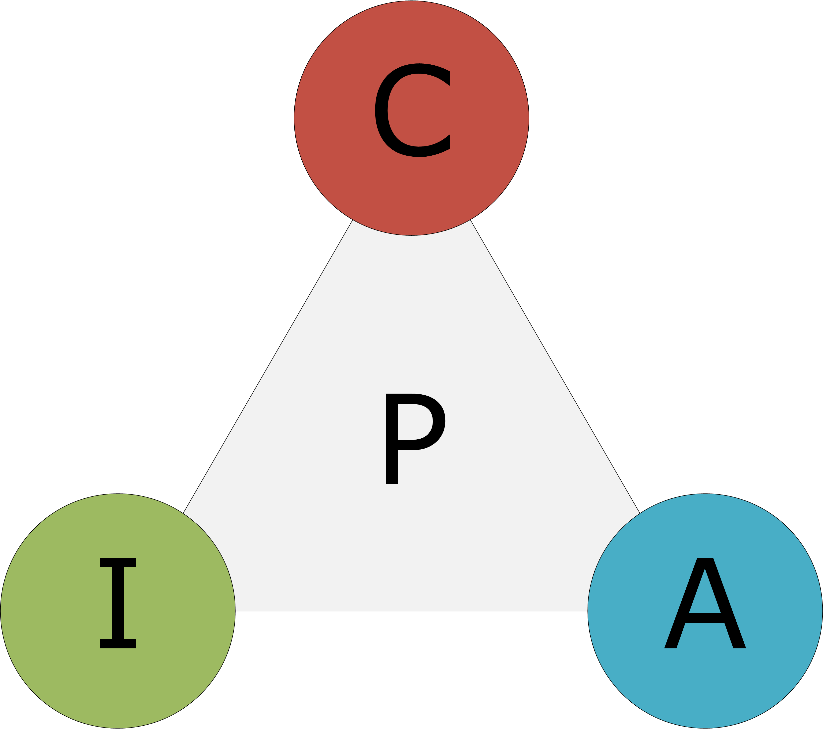
Core Principles
Confidentiality
Integrity
Availability
Privacy

Slide 3
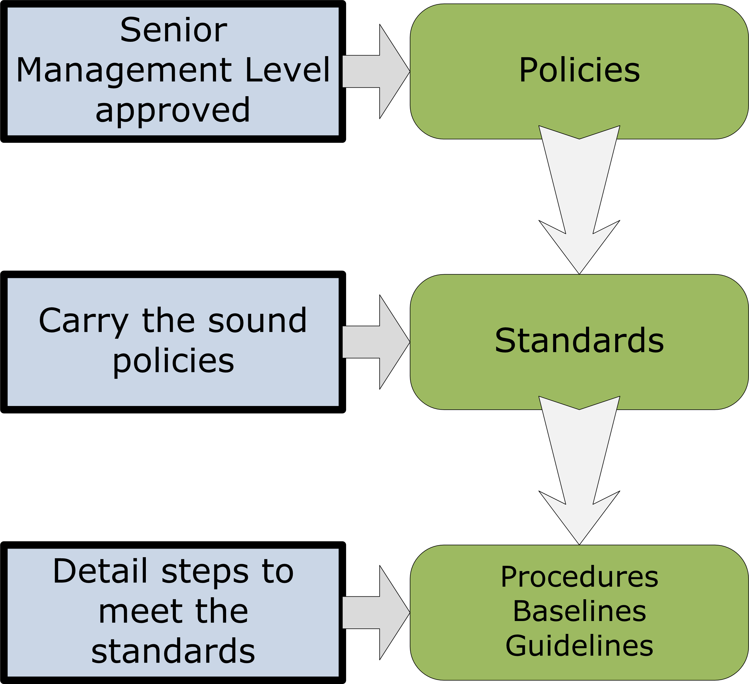
Management Governance
Policies
Standards
Procedures
Baselines
Guidelines

Slide 4
Audit Frameworks
ISACA – COBIT
AXELOS – ITIL
ISO/IEC 27001

Slide 5
Organizational Behavior
Organizational Structure & Environment
Best Practices
Hiring
Job Rotation
Separation of Duties
Least Privilege (Need to Know)
Job Position Sensitivity

Slide 6
Security-related Units
CEO / Board of Directors
CIO / IT dept.
HR / Legal dept.
Internal Audit dept.
Corporate Security Guards
(Chief) Information Security Officer

Slide 7
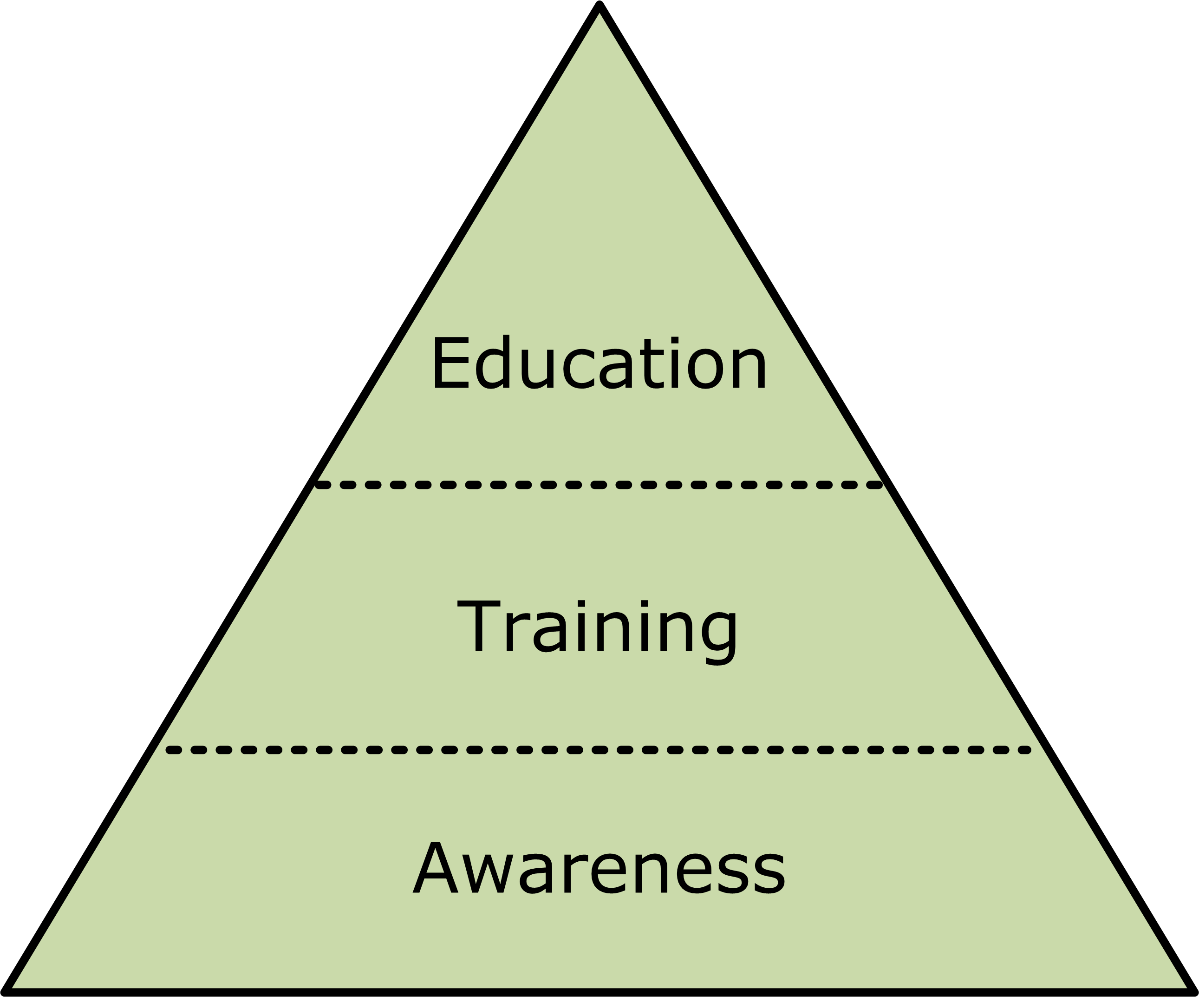
Security Courses
Awareness (ALL)
Training (MANY)
Education (SOME)

Slide 8
Risk Management
Concepts
Qualitative Assessments
Quantitative Assessments
Principles
Avoidance
Transfer
Mitigation
Acceptance
Ownership

Slide 9
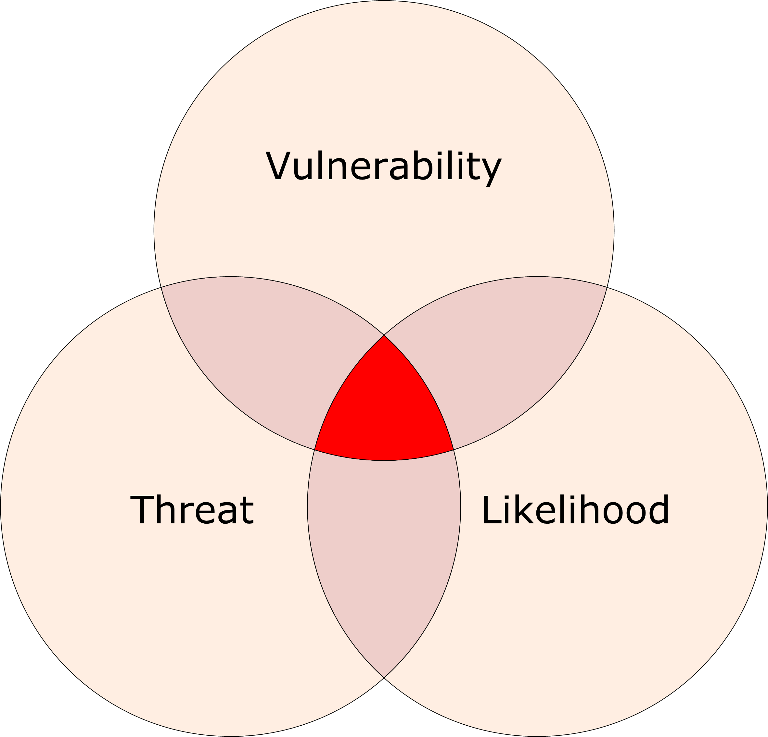
Risk Assessment
Identify Vulnerabilities
Identify Threats
Likelihood
Impact
RISK
Countermeasure
Valuation

Slide 10
“Security is a process,
not a product.”
-- Bruce Schneier
Computer Security and Privacy Specialist

Slide 11

Ethics & Professionals
Who watches the Watchmen?
Code of Conduct
Put the right MAN on the right JOB at the right TIME
.. with the right TOOLS!
Certifications
(ISC)2 – CISSP
EC-Council – CEH
ISACA – CISM
SANS – GIAC

